Slide 1
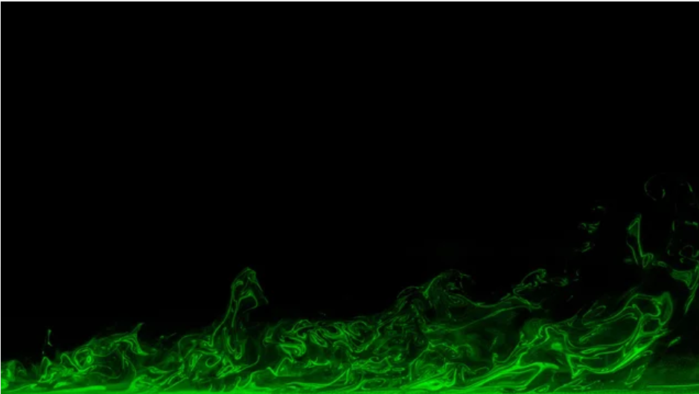





Design of a dynamic surface prototype using continuous servos for boundary layer control
Mae Carrington¹, Dr. Gokul Pathikonda¹
¹: Complex Mixing and Advanced Turbulence Lab, ASU, Tempe, AZ, USA

Slide 2
Table of Contents
1
Basic Ideas of Aerodynamics -
Boundary Layers
2
Project Goal and Dynamic Surface Purpose
3
What is a dynamic surface and how does it work?
4
Current State and future actions

Slide 3
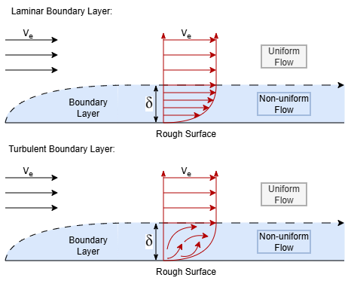
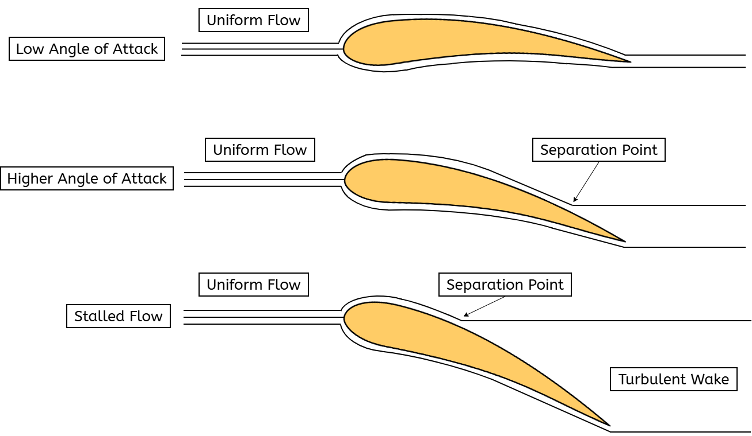
Boundary Layers
For on any surface that has friction
Small region in which the flow is not uniform
When pressure changes rapidly along the surface, the boundary layer can separate
This cause a big increase in drag and a big decrease in lift

Slide 4
Dynamic Surface - The Goal
Surface can replicate any geometry
Better able to characterize the boundary layer
Pressure Changes
Precise control over pressure

Slide 5
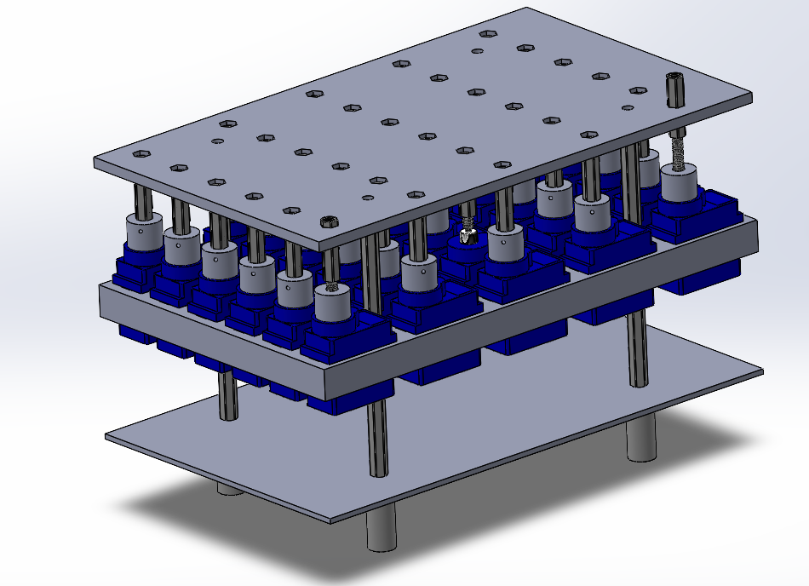
Dynamic Surface Design - Physical
Top Plate
Male and Female Screw Threading
Servo Layer
Servo-Screw Adaptor
PCB Layer
Magnetic Stand Offs

Slide 6
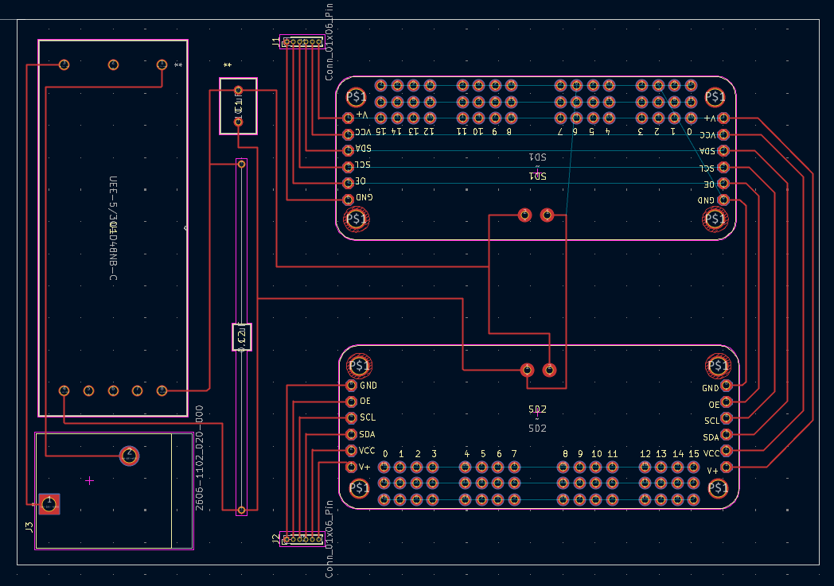
Dynamic Surface Design - Electronics
36V to 5V 30A Power Converter
Servo Drivers
Input Power Terminals
Decoupling Capacitors

Slide 7
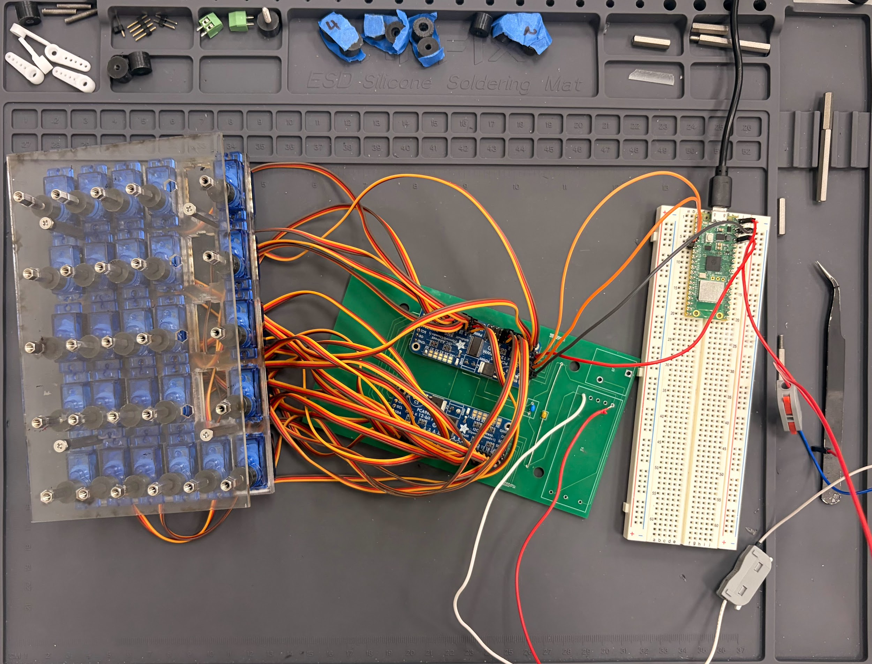
Dynamic Surface - Current State (as of March 2026)
Physical Assembly
Control 30 servos independently
26/30 servos
Assembled and working PCB

Slide 8
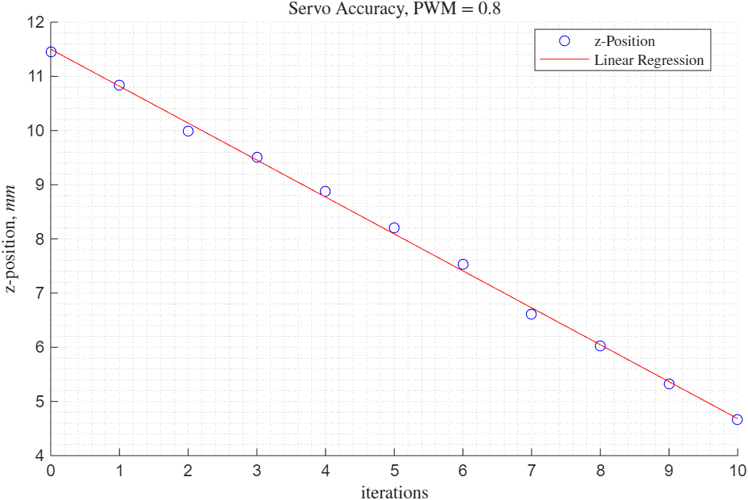
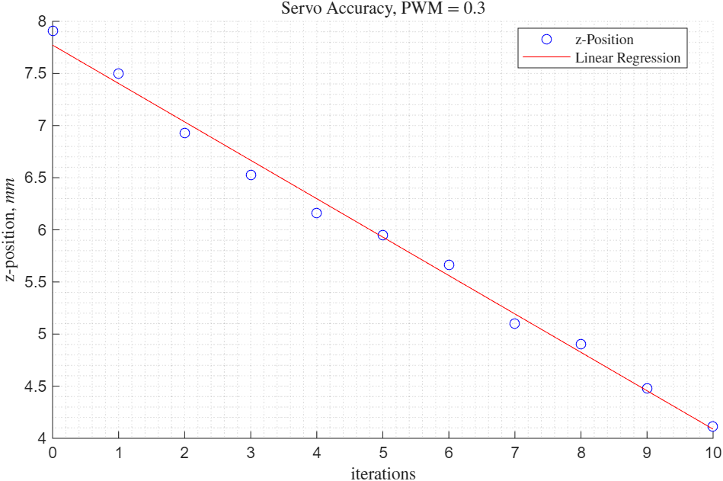
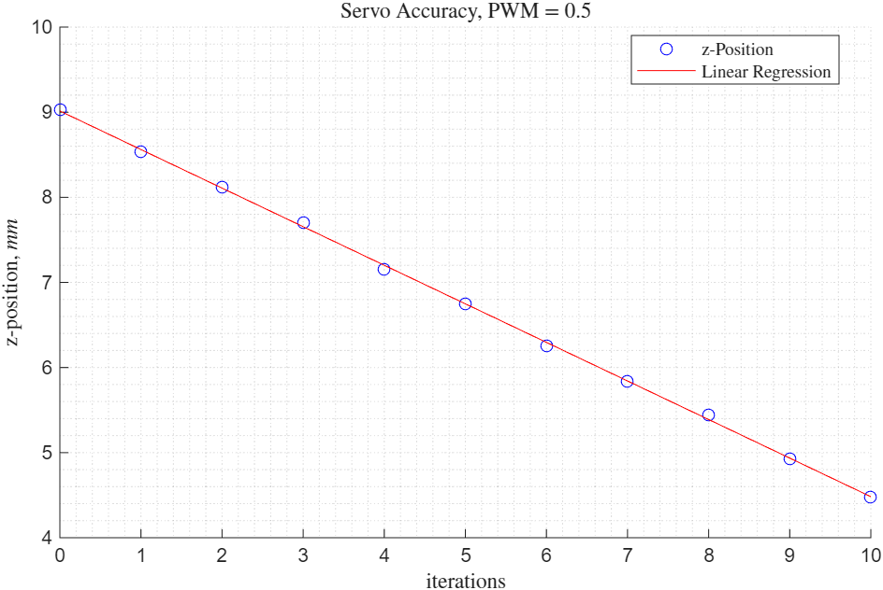
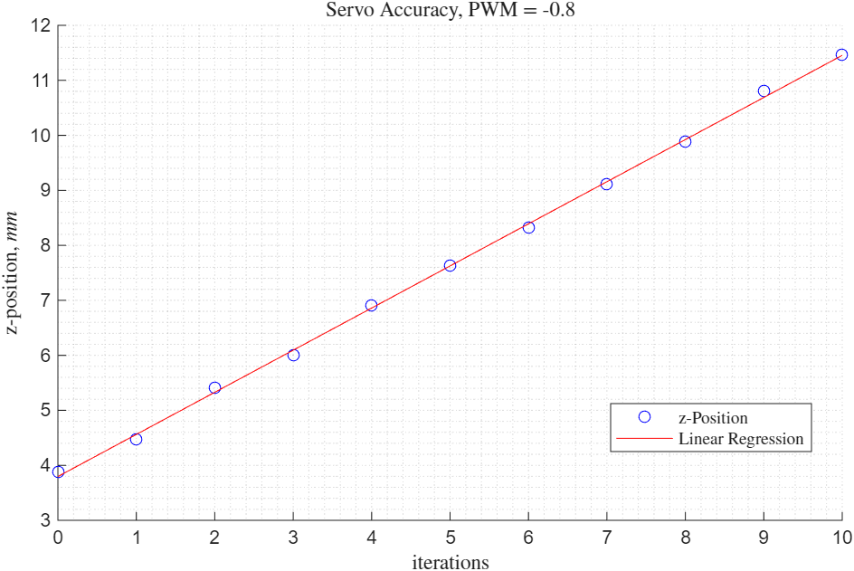
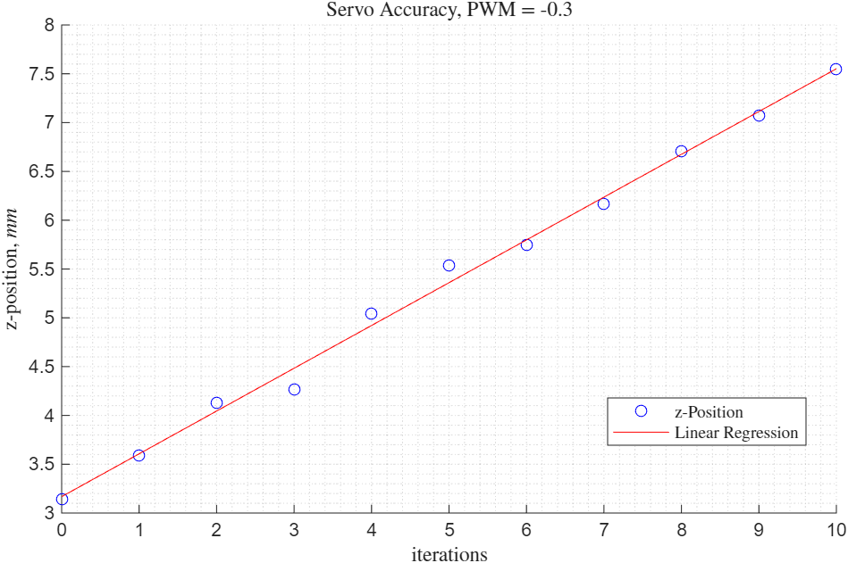
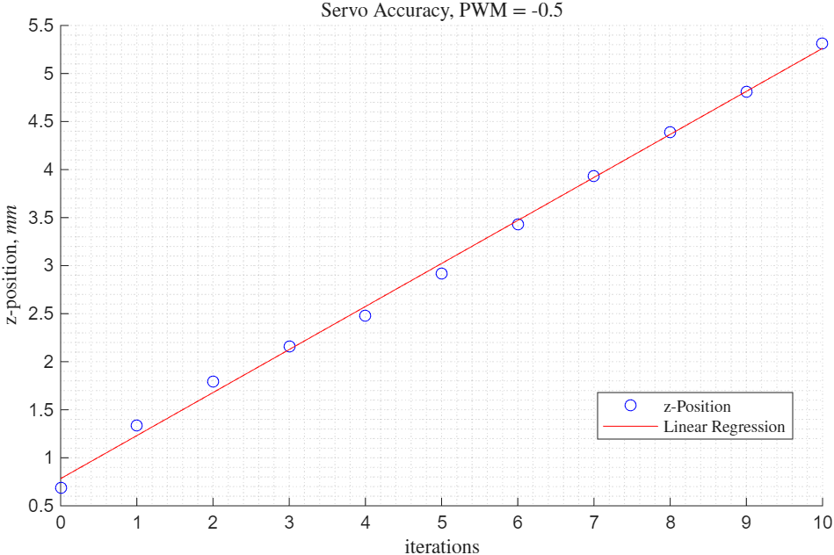
Dynamic Surface - Current State (as of March 2026)
z̄=-0.679
σ = 0.124
z̄=-0.380
σ = 0.125
z̄=0.455
σ = 0.054
z̄=0.5760
σ = 0.176
z̄=0.7580
σ = 0.126
z̄=0.441
σ = 0.178

Slide 9
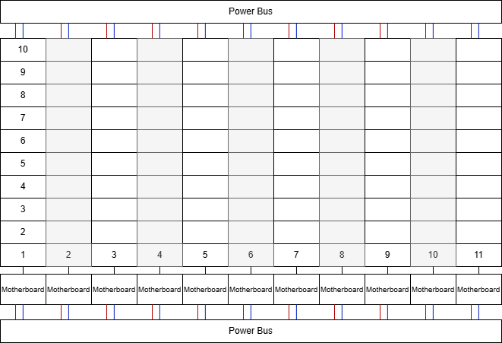
Dynamic Surface - Future Work
Fix issues with current model
Testing servo capability and accuracy
Update code structure
Expand modular pieces for full design

Slide 10
Thank you!
The material contained in this document is based upon work supported by the National Aeronautics and Space Administration (NASA) cooperative agreement 80NSSC25M7084. Any opinions, findings, conclusions or recommendations expressed in this material are those of the author and do not necessarily reflect the views of NASA. This work was supported through a NASA grant awarded to the Arizona/NASA Space Grant Consortium.

